Slide 1
Figures – Chapter 19

Slide 2
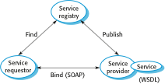
Figure 19.1 Service-oriented architecture

Slide 3
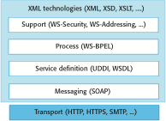
Figure 19.2 Web service standards

Slide 4
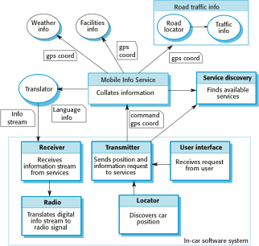
Figure 19.3 A service-based, in-car information system

Slide 5
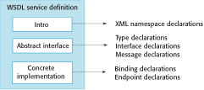
Figure 19.4 Organization of a WSDL specification

Slide 6
Figure 19.5 Part of a WSDL description for a web service
Define some of the types used. Assume that the namespace prefixes ‘ws’ refers to the namespace URI for XML schemas and the namespace prefix associated with this definition is weathns.
<types>
<xs: schema targetNameSpace = “http://.../weathns”
xmlns: weathns = “http://…/weathns” >
<xs:element name = “PlaceAndDate” type = “pdrec” />
<xs:element name = “MaxMinTemp” type = “mmtrec” />
<xs: element name = “InDataFault” type = “errmess” />
<xs: complexType name = “pdrec”
<xs: sequence>
<xs:element name = “town” type = “xs:string”/>
<xs:element name = “country” type = “xs:string”/>
<xs:element name = “day” type = “xs:date” />
</xs:complexType>
Definitions of MaxMinType and InDataFault here
</schema>
</types>
Now define the interface and its operations. In this case, there is only a single operation to return maximum and minimum temperatures.
<interface name = “weatherInfo” >
<operation name = “getMaxMinTemps” pattern = “wsdlns: in-out”>
<input messageLabel = “In” element = “weathns: PlaceAndDate” />
<output messageLabel = “Out” element = “weathns:MaxMinTemp” />
<outfault messageLabel = “Out” element = “weathns:InDataFault” />
</operation>
</interface>

Slide 7
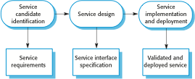
Figure 19.6 The service engineering process

Slide 8
Figure 19.7 Service classification
 | Utility | Business | Coordination
Task | Currency converter Employee locator | Validate claim form Check credit rating | Process expense claim Pay external supplier</TB>
Entity | Document style checker Web form to XML converter | Expenses form Student application form

Slide 9
Figure 19.8 Functional descriptions of catalog service operations
Operation | Description
MakeCatalog | Creates a version of the catalog tailored for a specific customer. Includes an optional parameter to create a downloadable PDF version of the catalog.
Compare | Provides a comparison of up to six characteristics (e.g., price, dimensions, processor speed, etc.) of up to four catalog items.
Lookup | Displays all of the data associated with a specified catalog item.
Search | This operation takes a logical expression and searches the catalog according to that expression. It displays a list of all items that match the search expression.
CheckDelivery | Returns the predicted delivery date for an item if ordered that day.
MakeVirtualOrder | Reserves the number of items to be ordered by a customer and provides item information for the customer’s own procurement system

Slide 10
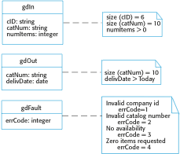
Figure 19.9 Catalog interface design

Slide 11
Figure 19.10 UML definition of input and output messages
Operation | Inputs | Outputs | Exceptions
MakeCatalog | mcIn Company id PDF-flag | mcOut URL of the catalog for that company | mcFault Invalid company id
Compare | compIn Company id Entry attribute (up to 6) Catalog number (up to 4) | compOut URL of page showing comparison table | compFault Invalid company id Invalid catalog number Unknown attribute
Lookup | lookIn Company id Catalog number | lookOut URL of page with the item information | lookFault Invalid company id Invalid catalog number
Search | searchIn Company id Search string | searchOut URL of web page with search results | searchFault Invalid company id Badly formed search string
CheckDelivery | gdIn Company id Catalog number Number of items required | gdOut Catalog number Expected delivery date | gdFault Invalid company id Invalid catalog number No availability Zero items requested
PlaceOrder | poIn Company id Number of items required Catalog number | poOut Catalog number Number of items required Predicted delivery date Unit price estimate Total price estimate | poFault Invalid company id Invalid catalog number Zero items requested

Slide 12
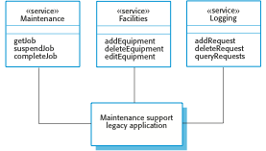
Figure 19.11 Services providing access to a legacy system

Slide 13
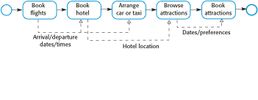
Figure 19.12 Vacation package workflow

Slide 14

Figure 19.13 Service construction by composition

Slide 15
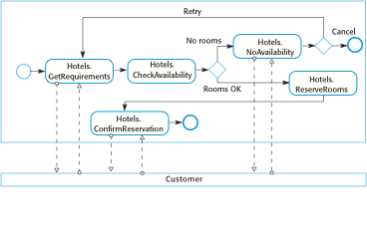
Figure 19.14 A fragment of a hotel booking workflow

Slide 16
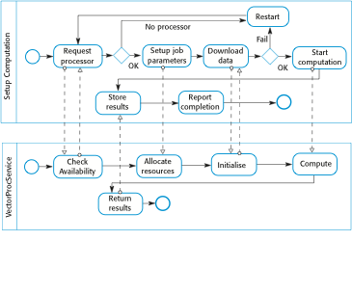
Figure 19.15 Interacting workflows

